Slide 1
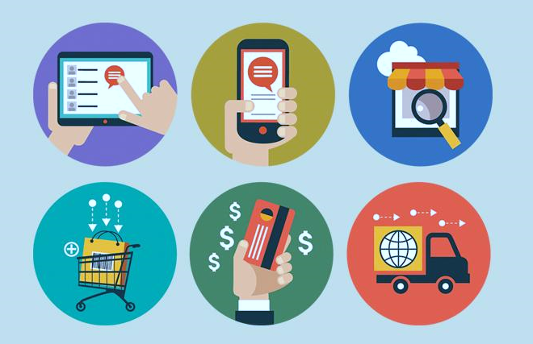
DIGITAL PAYMENTS ANALYSIS
Dataset used : National Data & Analytics Platform

Slide 2
Overview
The Digital India program is a flagship program of the Government of India with a vision to transform India into a digitally empowered society and knowledge economy. Digital India promotes cashless transactions and aims to convert India into a cashless society.
This campaign was launched on 1 of July 2015 by the government of India under the rule of Prime Minister- Narendra Modi with a motto of – “Power to Empower”.

Slide 3
Analysis OVERVIEW
The dataset is provided by Ministry of Electronics and Information Technology and can be downloaded from National Data and Analytical platform.(NDAP) The dataset includes the information from the year 2017 -2022
The analysis is done using various libraries of python and certain conclusions are derived to identify certain trends and pattern over the years

Slide 4
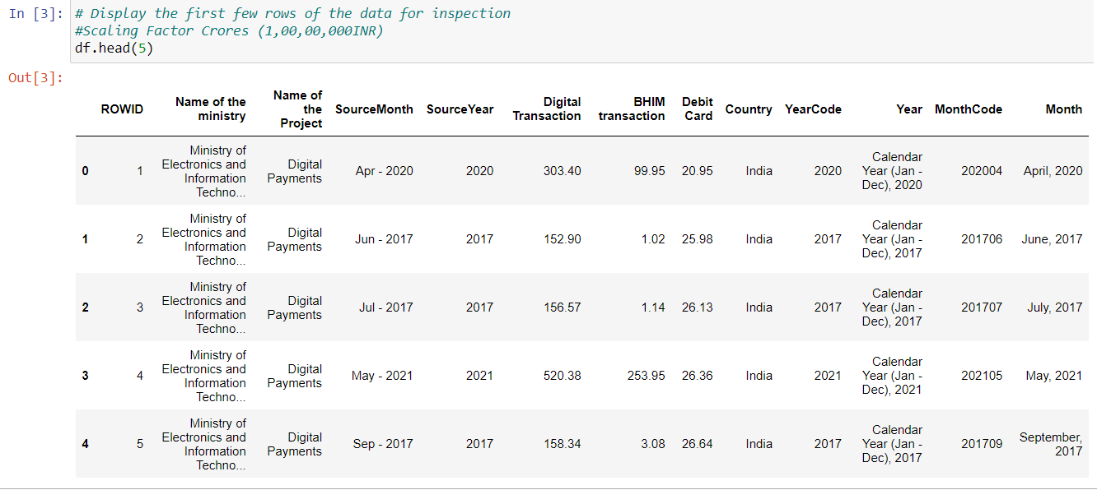
The data has categorized the digital payments into 3 categories i.e. Digital Transaction, BHIM Transaction and Debit card Transaction

Slide 5
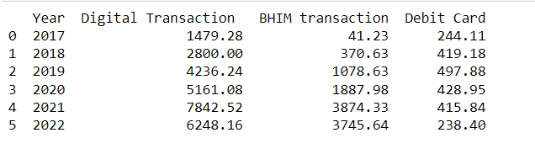
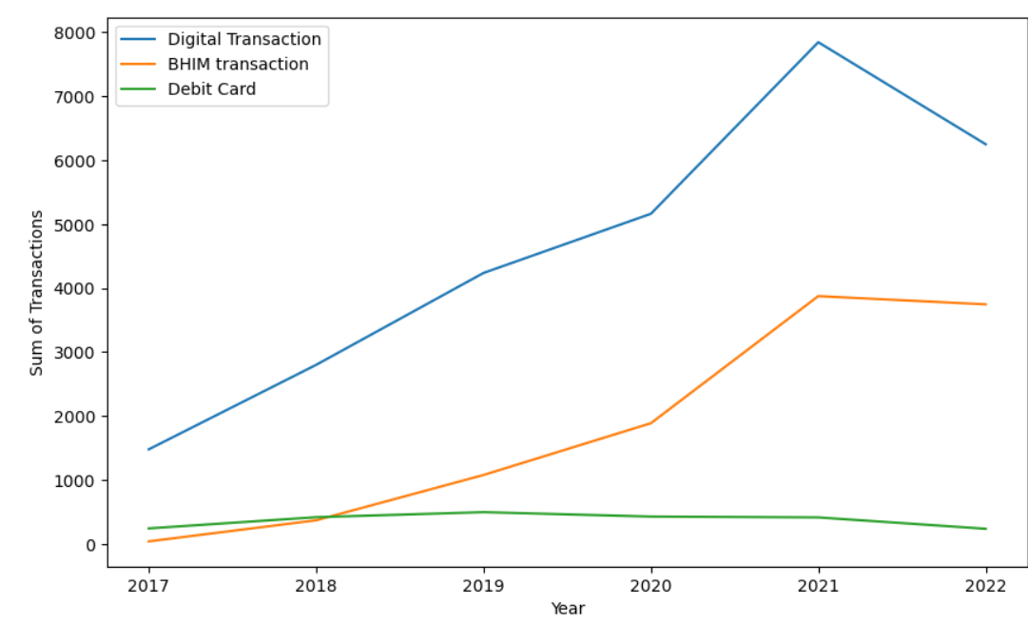
sum of transactions for each type and year
The total value of Digital Transactions has shown a consistent growth over the years, with a substantial increase from 2017 to 2022.
BHIM Transactions experienced fluctuations, with a significant increase in 2021. This might indicate a variation in user adoption or changes in BHIM-related activities during these years.
Debit Card transactions have remained relatively stable over the years, with some variations but not showing a clear increasing or decreasing trend.

Slide 6
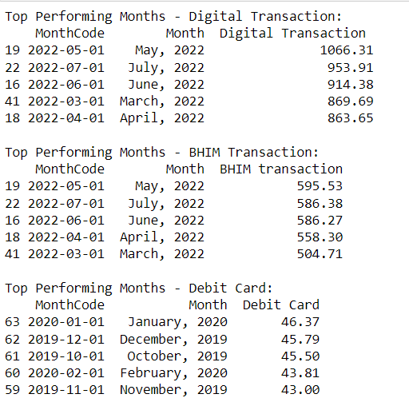
Top-performing months
Overlap in Top Months: There is some overlap in the top months for Digital and BHIM Transactions, suggesting a correlation in their performance during specific periods.
Distinct Debit Card Peaks: Debit Card transactions exhibit different peak months, indicating that factors influencing Debit Card usage may differ from those affecting digital and BHIM transactions.
Note:-It's essential to consider external factors, events, or marketing campaigns that might have influenced transaction trends during these months. Further analysis, including statistical tests or regression analysis, could help identify and understand the drivers behind these transaction patterns.

Slide 7
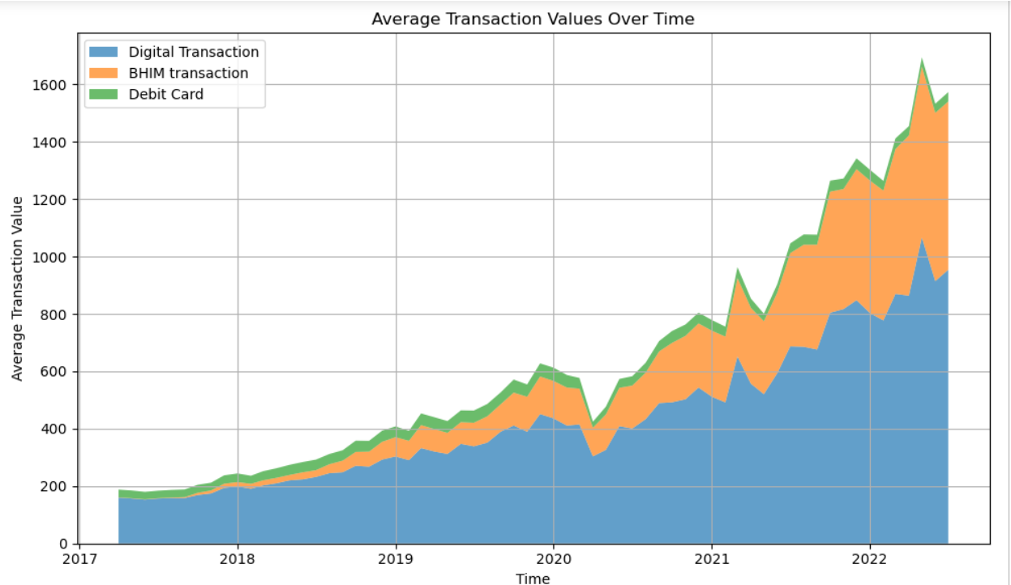
Average transaction values over time
Digital Transactions Dominance: Digital Transactions contribute the most to the overall average transaction values. This could indicate a higher reliance on digital payment methods compared to BHIM transactions and debit card usage.
BHIM Transaction Contribution: BHIM transactions, while lower than Digital Transactions, still make a noticeable contribution. The stacked area chart allows you to see the relative proportion of BHIM transactions to the total.
Debit Card Usage: Debit card transactions seem to have the smallest contribution, suggesting that they might be less prevalent or have lower average values compared to digital and BHIM transactions.

Slide 8
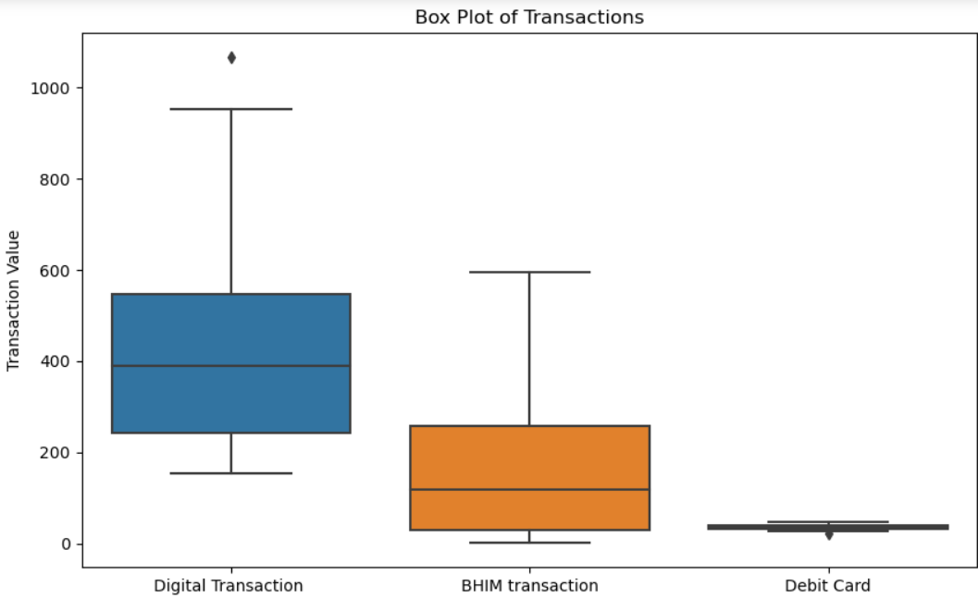
distribution of transactions
Digital Transaction has the highest median value, indicating that, on average, the central transaction value is higher for Digital Transaction compared to BHIM Transaction and Debit Card.
The IQR for Digital Transaction is larger than that for BHIM Transaction and Debit Card. This suggests that the middle 50% of Digital Transaction values is spread over a wider range compared to the other two types.
Digital Transaction has more outliers on the higher end, indicating occasional instances of very high transaction values. This might suggest certain peak periods or exceptional transactions for Digital Transaction.
The order of medians (Digital Transaction > BHIM Transaction > Debit Card) aligns with the observed order of the central tendency of the data.

Slide 9
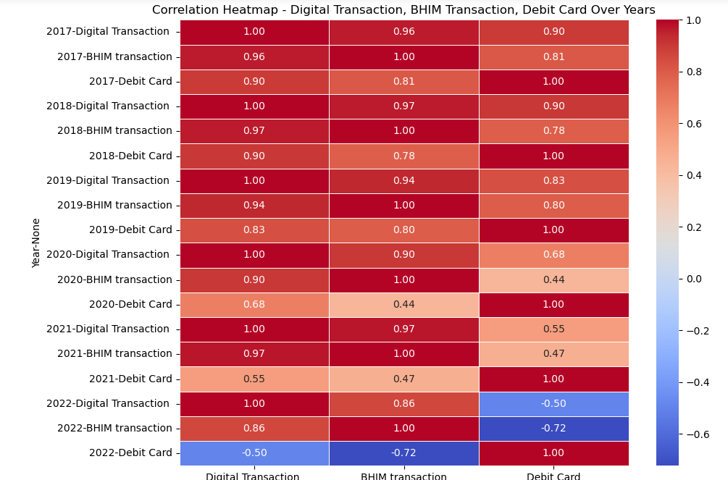
Correlation analysis using heatmap
Value close to 1 between 'Digital Transaction' and 'BHIM Transaction' suggests that when 'Digital Transaction' increases, 'BHIM Transaction' tends to increase as well.
Correlation close to 0 implies that changes in one variable are not strongly associated with changes in the other variable .
The colour intensity in the heatmap represents the strength of the correlation. Darker colours (either dark red or dark blue) indicate stronger correlations, while lighter colours represent weaker correlations

Slide 10
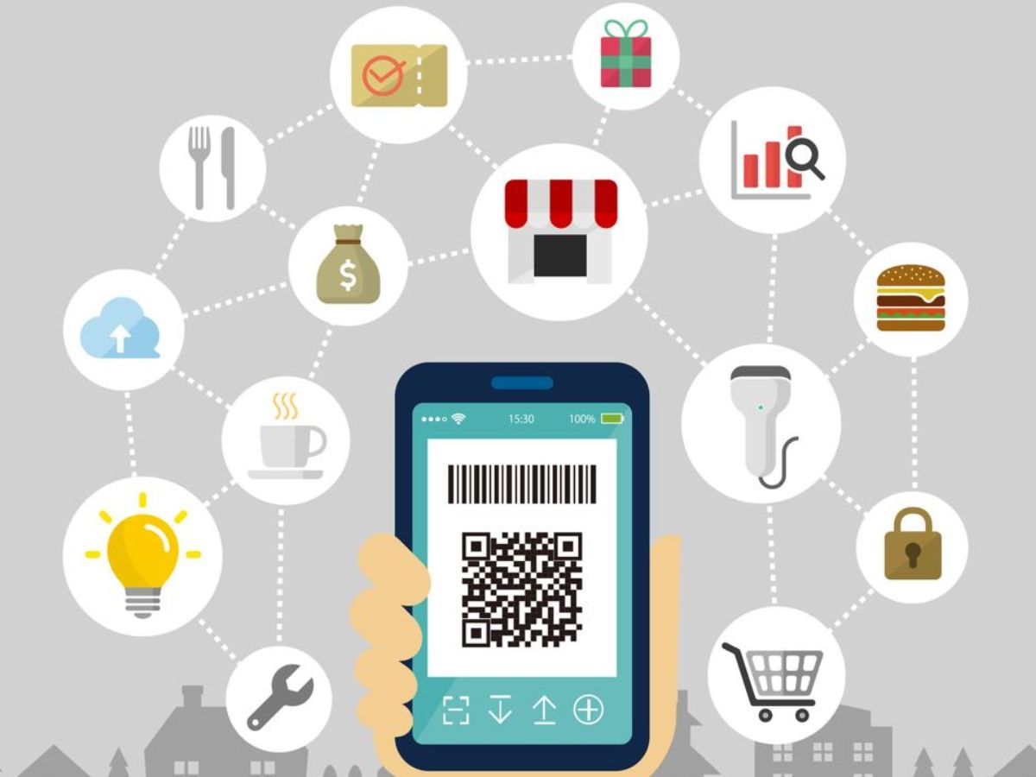
Conclusion
The analysis suggests a shift towards digital transactions, reflecting changing consumer preferences and technological advancements.
Variations in transaction types over the years may be influenced by external factors, economic conditions, or specific events.
Digital transactions play a central role in the overall transaction landscape, emphasizing the importance of digital payment methods.

Slide 11


